Slide 1
Oshun Movement LLC presents: The Art of sensual health
T.A.S.H is a Sisterhood guided by the Fundamental Elements Necessary to LIVE Sensual
For more info contact Oshun Marcella
healthyomt@yahoo.com
305-917-3467

Slide 3
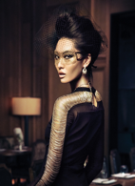
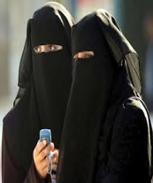
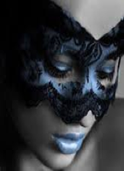
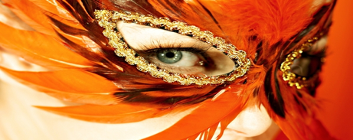

Slide 4
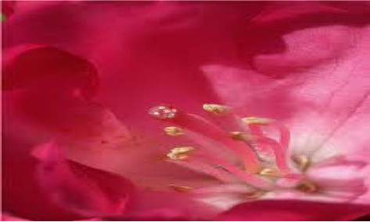

Slide 5
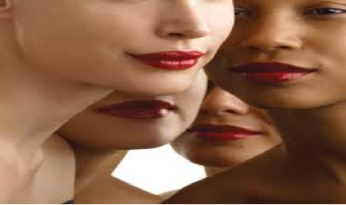

Slide 8
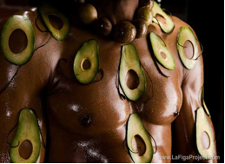
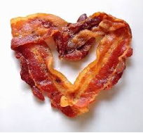
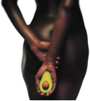

Slide 10
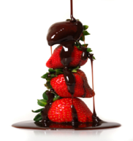
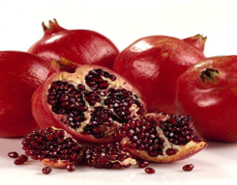
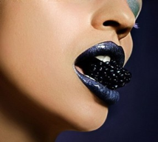

Slide 11
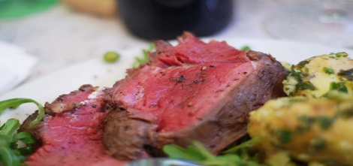

Slide 12
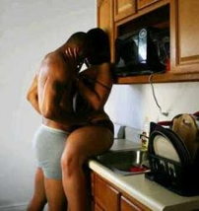

Slide 13
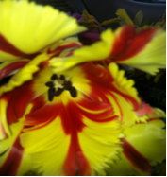
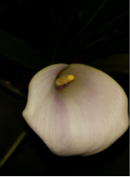
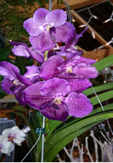

Slide 15
Sensuality
True Sensuality is a feeling that you feel deep inside your soul, a feeling of knowing you are truly a person of deep emotional love for yourself and others.
A True Sensual person radiates an aura all around them, you can feel it when in their presence, you are draw to them, you can feel their magnetism, you feel so good while in their presence...
They are kind, caring and beautiful from within. When they choose to share their sensuality physically with a special person, that person can feel the power of their love coming from within their soul.
Their sensuality goes further than Sex; it will intensify and explode as it sends such power of feeling and emotion to your body and soul. It comes from deep inside the body, heart and soul!!!
Copyright 2014 The Classy Woman. All rights reserved

Slide 17
A sensual woman embodies femininity in all its magnificence and is absolutely mesmerizing to those around her. She possesses a certain sparkling quality that radiates from the inside out.
Sensuality starts with a heightened awareness to pleasure. Not just the kind of pleasure found in the bedroom, (although important ;) -- it’s also seeking to find enjoyment in all things. Thus sensual women have more sex, experience more pleasure in life, and feel at peace with who they are.
Sounds good, right?!
It is good. In fact, it’s better than good - it’s blissful!
Studies have shown that women who are exceptionally sensual live for the moment and are not stuck in the past or pre-occupied with the future. They take pleasure in life moment by moment delighting in the fullness of each experience.
Sensuality at its core is enjoyment; enjoyment of experiences, people, intimacy, and most importantly enjoyment of self.

Slide 18
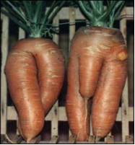
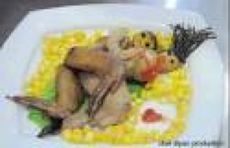
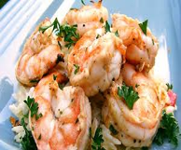

Slide 19
Aromas that are sensory stimulators
JASMINE LAVENDER
PEPPERMIMT CHAMOMILE
VANILLA TANGERINE
MUSK COCONUT
SANDALWOOD YLANG YLANG
FRANKINCENSE CHOCOLATE
ROSE CINNAMON
PATCHOULI PUMPKIN PIE

Slide 20
The effects include relaxation, lowered inhibitions, heightened sensitivity, and feelings of euphoria

